Slide 1
Materials processing with intelligent systems
(MICRO-457)
Introduction
Shevchik Sergey & Patrik Hoffmann

Slide 2
Content of the lecture
Who are we?
What is advanced materials processing?
What is intelligent systems?
Why this lecture?
Main objectives of this lecture?
  Acoustics (use, type, else)
  Optics
  Opto-acoustic (in particular Fiber Bragg Grating)
  Visual
Materials processing with intelligent systems (MICRO-457) Shevchik S. & Hoffmann P.

Slide 3



Who are we?
Prof. Dr. Patrik Hoffmann
Head of laboratory
Laboratory for Advanced Materials Processing (LAMP)
Dr. Sergey Shevchik
Scientist
Intelligent Manufacturing Group (IMG)
Laboratory for Advanced Materials Processing (LAMP)
Ms. Abdollahinejad, Golnoosh
PhD
Intelligent Manufacturing Group (IMG)
Laboratory for Advanced Materials Processing (LAMP)
Empa – Swiss Federal Laboratories for Materials Science & Technology
Materials processing with intelligent systems (MICRO-457) Shevchik S. & Hoffmann P.

Slide 4
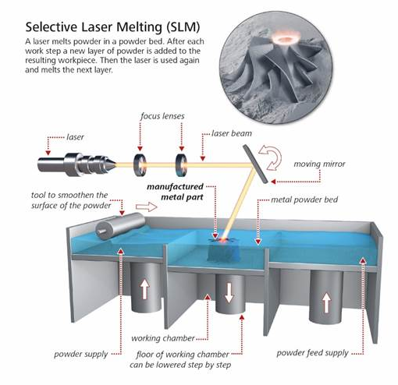
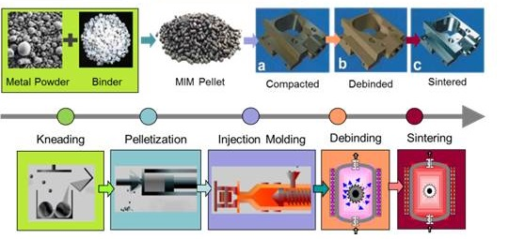
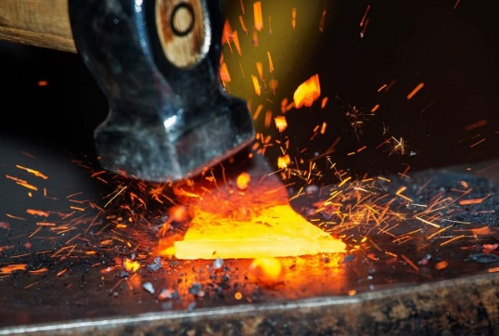
What is advanced materials processing?
Advanced materials processing (and manufacturing) is the use of innovative technology to improve products or processes, with the relevant technology being described as "advanced," "innovative," or “cutting edge“.
Source Wikipedia
Materials processing with intelligent systems (MICRO-457) Shevchik S. & Hoffmann P.

Slide 5
What are intelligent systems?
Definition
  An intelligent system is a machine with an embedded, Internet-connected computer that has the capacity to gather and analyze data and communicate with other systems. Other criteria for intelligent systems include the capacity to learn from experience, security, connectivity, the ability to adapt according to current data and the capacity for remote monitoring and management.
Margaret Rouse WhatIs.com
Materials processing with intelligent systems (MICRO-457) Shevchik S. & Hoffmann P.

Slide 6
What are intelligent systems?
Definition
  Intelligent systems are embedded with elements of artificial intelligence and are emerging in response to the convergence of the virtual and physical worlds through the development of autonomous systems, wearable technologies, robotic co-workers, smart devices, drone technology, augmented reality, intelligent houses, digital twins, intelligent manufacturing, and many other applications.
Center for Intelligent Systems (CIS) EPFL
Materials processing with intelligent systems (MICRO-457) Shevchik S. & Hoffmann P.

Slide 7
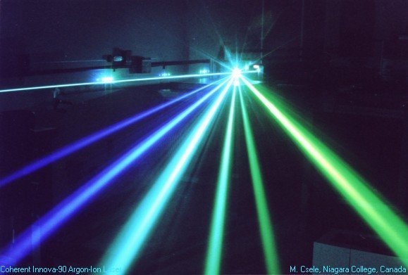
LASER
Light
Amplification by
Stimulated
Emission
Radiation
Legal
Amusement of
Students
Engineers and
Researchers
Basics of lasers in case of interest:
Principles of Lasers. by Orazio Svelto (Springer, 5ed. 2010).
Lasers. by Anthony E. Siegman. (Univ Science Books, 1986)
Materials processing with intelligent systems (MICRO-457) Shevchik S. & Hoffmann P.

Slide 8
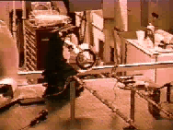
Laser processing: some nice examples
Laser «shooting"
Laser cutting
Materials processing with intelligent systems (MICRO-457) Shevchik S. & Hoffmann P.

Slide 9
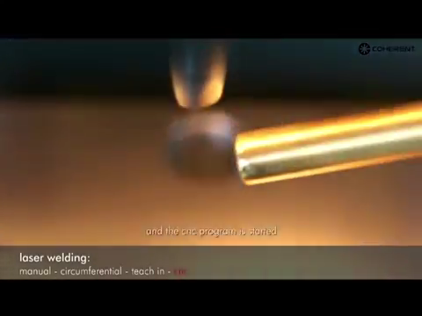
Laser processing: some nice examples
Laser welding
Laser marking / laser engraving
https://www.youtube.com/watch?time_continue=323&v=xXaabt9urss&feature=emb_logo
https://www.youtube.com/watch?v=TwSeFoD72EA&feature=emb_logo
Materials processing with intelligent systems (MICRO-457) Shevchik S. & Hoffmann P.

Slide 10
Laser processing: some nice examples
https://www.youtube.com/watch?v=B2j-51LfL60&feature=emb_logo
Materials processing with intelligent systems (MICRO-457) Shevchik S. & Hoffmann P.

Slide 11

Why monitoring a laser process is important?
https://www.youtube.com/watch?v=Pjqysyy1ySs
Materials processing with intelligent systems (MICRO-457) Shevchik S. & Hoffmann P.

Slide 12
Laser processing: some nice examples
3D printing
https://www.youtube.com/watch?v=Pjqysyy1ySs
Materials processing with intelligent systems (MICRO-457) Shevchik S. & Hoffmann P.

Slide 13
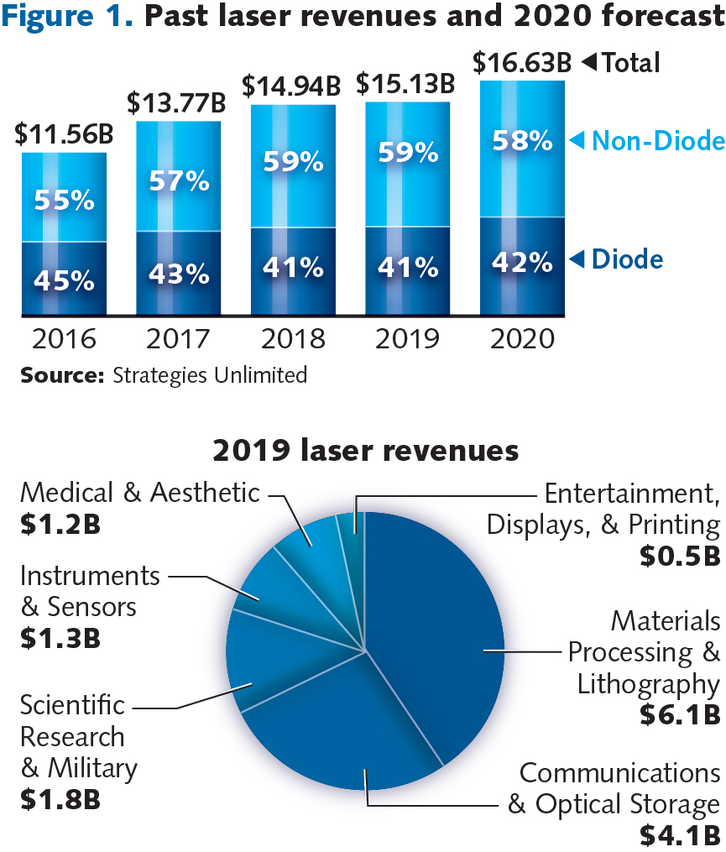
Laser market segments
2019 total laser revenues: $ 15.0B
Materials processing with intelligent systems (MICRO-457) Shevchik S. & Hoffmann P.

Slide 14
Past laser revenues and 2020 forecast
Materials processing with intelligent systems (MICRO-457) Shevchik S. & Hoffmann P.

Slide 15
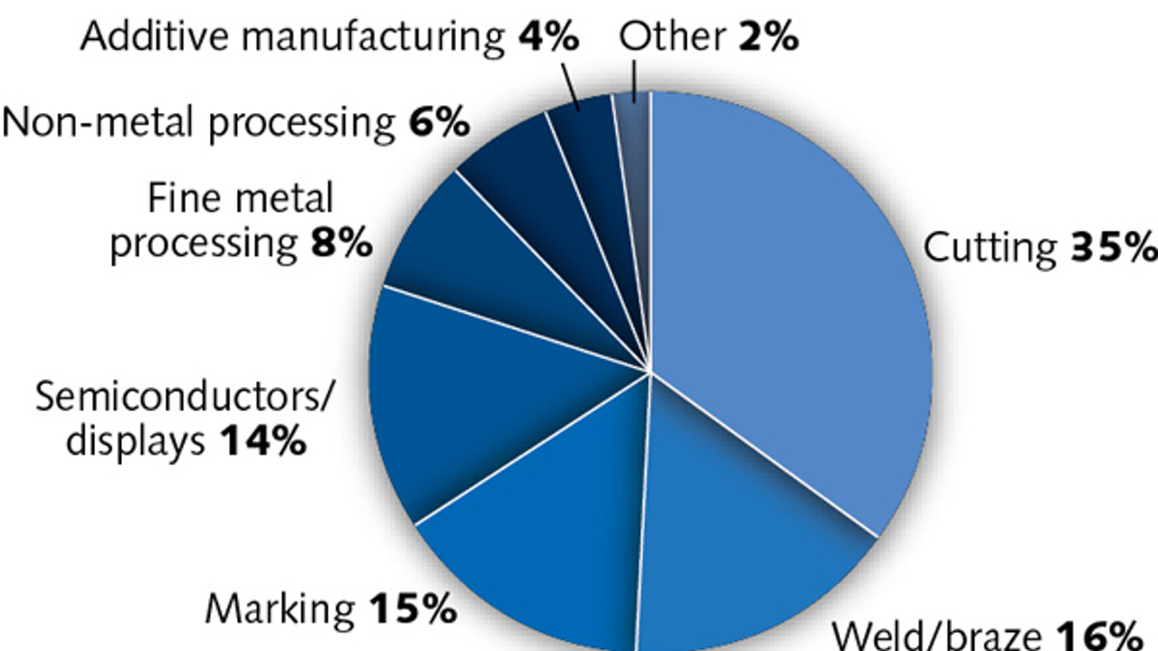
Industrial laser applications 2017
Materials processing with intelligent systems (MICRO-457) Shevchik S. & Hoffmann P.

Slide 16
Different laser processes
Conduction welding
Keyhole welding
Heat the material above melting temperature but without evaporation
Heat the material above the evaporation temperature and create a keyhole
Melted materials
Weld depth
Plume
Keyhole
Melted materials
Weld depth
Heat affected zone (HAZ)
1
2
3
3
4
1
2
Quelle: Rofin-Baasel, Fine Welding with Lasers
Aspect ratio (depth/diameter): ~1
Weld depth < 1 mm
Aspect ratio (depth/diameter) < 10
Keyhole-diameter ≈ Spot ∅
CW max. depth f(laser power)
Pulse depth: max. depth ≈ 3 mm
Materials processing with intelligent systems (MICRO-457) Shevchik S. & Hoffmann P.

Slide 17
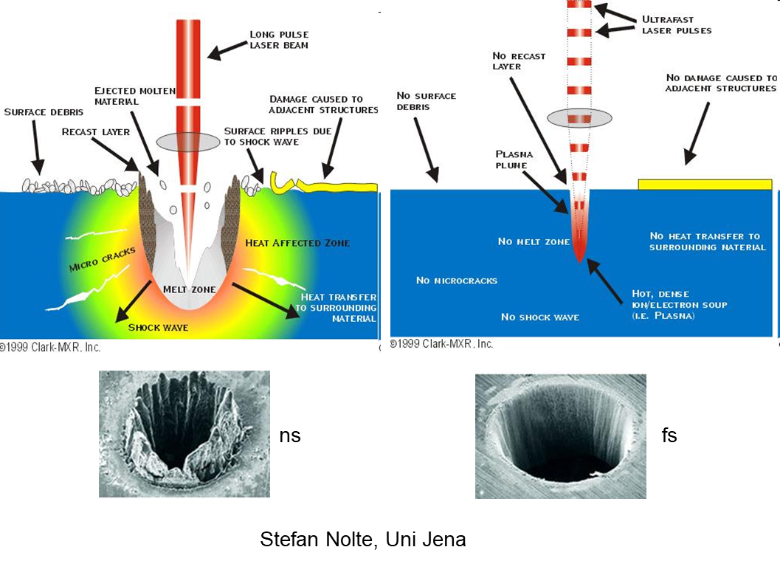
Comparison of laser pulse duration
Materials processing with intelligent systems (MICRO-457) Shevchik S. & Hoffmann P.

Slide 18
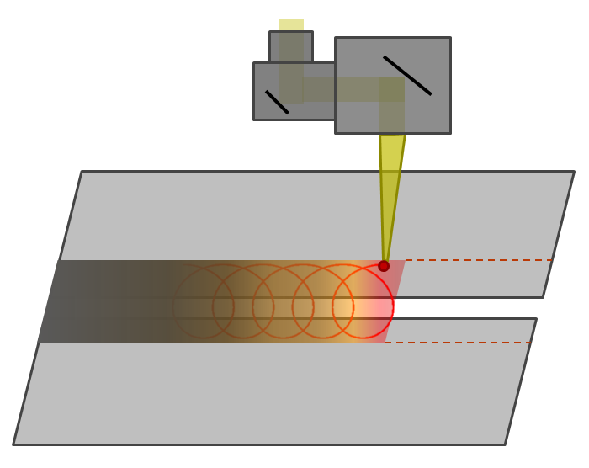
There are many laser processing parameters
Laser beam characteristics
Peak power
Pulse width
Spot size
Beam quality
Wavelength
Mode
Polarization
Spatial profile
Temporal profile
Quality parameters
Weld geometry
Penetration
Weld width/reinforcement
Fusion area
HAZ area
Surface roughness
Bumping/undercut
Spattering
Oxidation/coloration
Porosity
Hardness
Tensile/shear strength
Stiffness
Distortion
Thermal efficiency
Cost
23 possible parameters!
Process parameters
Wobbling speed
Welding speed
Focal position
Beam inclination
Operation environment
Joint design
Alignment, gap size, etc.
Material properties
Thickness
Reflectivity
Chemical components
Mechanical properties
Thermal properties
Surface finish
Oxidation
Materials processing with intelligent systems (MICRO-457) Shevchik S. & Hoffmann P.

Slide 19

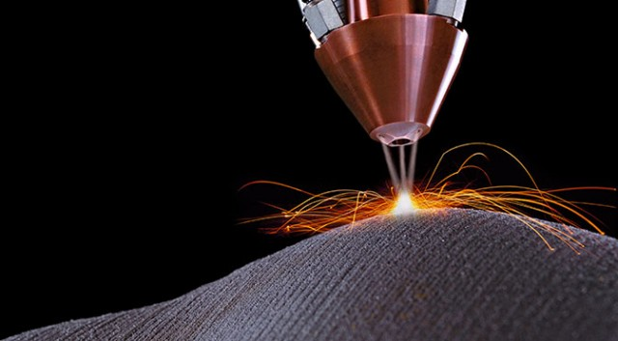
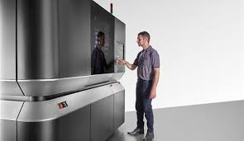

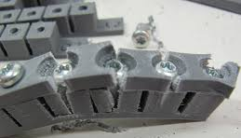
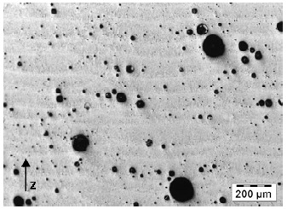
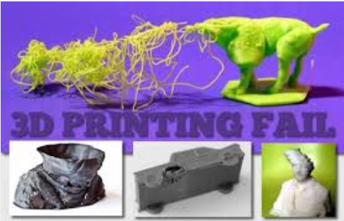
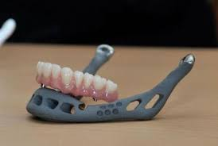
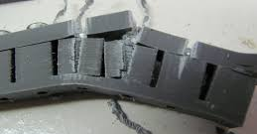
The laser processing of materials
The motivation
Laser processing: the reality
WHY!
Next workpiece
Starting the AM process
The AM process itself
What happened to my sample?
What happened to my sample?
The sample breaks after the process end
Defect occuring during the process
the sample is good
Materials processing with intelligent systems (MICRO-457) Shevchik S. & Hoffmann P.

